Slide 1
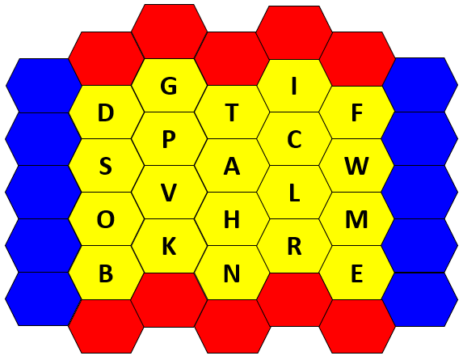
Blockbusters
(ABC Quiz)
From www.tinyteflteacher.co.uk
Notes:
Select a letter and answer a question – the first team to guess the answer claims that letter. The red team should try to join red to red, the blue team should try to join blue to blue – the winning team is the team who make the connection.

Slide 2
G
I
Choose a letter and listen to the question.
Each turn, the first team (red or blue) to guess the answer wins the letter and can choose the next letter.
The red team should try to cross from red to red, and the blue team should try to cross from blue to blue – the winner is the first team to link their colours.
Good luck!
D
T
F
P
C
S
A
W
V
L
O
H
M
K
R
B
N
E
(Press Esc to end the game.)

